Slide 1





CALCULATOR LANGAUGE
PRESENTED BY:
Ahmad Mustafa
Usaira Shahbaz
Tahir Iqbal

Slide 2
INTRODUCTION
TO BUILD A CUSTOM PROGRAMMING LANGUAGE WITH AN INTERACTIVE IDE.
PROVIDE HANDS-ON EXPERIENCE IN COMPILER DESIGN.
Key Focus Areas
Lexical Analysis
Syntax Analysis
Semantic Analysis
Intermediate Code Generation
Target Code Generation

Slide 3

Python
Core programming language
Modules
os: Interacting with the operating system.
time: Measuring execution time.
re: Handling regular expressions.
math: Performing mathematical operations.
graphviz: Visualizing parse trees.
Tool
VS Code
TOOLS AND TECHNOLOGIES USED

Slide 4
FEATURES OF IDE
Run Code
Execute programs within the IDE.
Visualization Tree
Parse tree display for better understanding.
Save/Load Code
Manage files efficiently.
Reset Code
Clear the code editor.
Save Code History
Maintain a log of code versions for future reference.
Output Display
Tokens, Assembly Code, and Intermediate Representation (IR) using Three-Address Code (TAC)
Theme Toggles

Slide 5
CORE LANGUAGE FEATURES
VAR
Declare variables.
ADD
Addition operation
DIV
Division operation
MUL
Multiplication operation
LOG
Logarithmic function
PRINT
Output values
COS
Cosine function
SIN
Sine function
TAN
Tangent function
POW
Power function
SUB
Subtraction operation
Handling Negative Values: Support for operations with negative numbers.
Skipping White Spaces: Ignore unnecessary spaces in code.

Slide 6

IMPLEMENTATION OF PHASES
Lexical Analysis
Syntax Analysis
Semantic Analysis
Intermediate Code Generation
Target Code Generation
Execution:

Slide 7

LEXICAL ANALYSIS
FUNCTION: BREAKS SOURCE CODE INTO TOKENS.
EXAMPLE:
INPUT: VAR X = 10;
OUTPUT: "[VAR, X, =, 10]"
Page 07

Slide 8
SYNTAX ANALYSIS
FUNCTION: CONSTRUCTS A PARSE TREE.
OUTPUT: ABSTRACT SYNTAX TREE (AST).
EXAMPLE:
INPUT: X = ADD(5, 3);
OUTPUT: ASSIGNMENT -> [IDENTIFIER, FUNCTIONCALL -> [ARGUMENTS]]

Slide 9
SEMANTIC ANALYSIS
FUNCTION: ENSURES CORRECTNESS OF LOGIC.
CHECK:
UNDECLARED VARIABLES.
TYPE MISMATCHES.
EXAMPLE:
ERROR: USING X WITHOUT DECLARATION.

Slide 10
CODE GENERATION
OUTPUT:
THREE-ADDRESS CODE (TAC):
T1 = 5 + 3; X = T1;
ASSEMBLY CODE:
LOAD 5; ADD 3; STORE X;

Slide 11
PROGRAM EXAMPLE
INPUT CODE:
VAR X = 5;
VAR Y = 10;
VAR Z = ADD X Y;
PRINT Z;
OUTPUT:
TOKENS: ["VAR", "X", "=", "5"]
SYNTAX TREE: DISPLAYED AS A PARSE TREE.
EXECUTION: OUTPUT: 15

Slide 12

ERROR HANDLING
LEXICAL ERRORS:
INVALID CHARACTERS.
Syntax Errors:
Structural mistakes.
Semantic Errors:
Logical inconsistencies.
Feedback:
Real-time messages in the output section.
Page 09

Slide 13
CONCLUSION
ACHIEVEMENT:
FULLY FUNCTIONAL CUSTOM PROGRAMMING LANGUAGE AND IDE.
INTERACTIVE LEARNING TOOL FOR COMPILER CONCEPTS.
FUTURE WORK:
ADD MORE ADVANCED FEATURES LIKE DEBUGGING AND OPTIMIZATION.
EXTEND LANGUAGE CAPABILITIES.

Slide 14
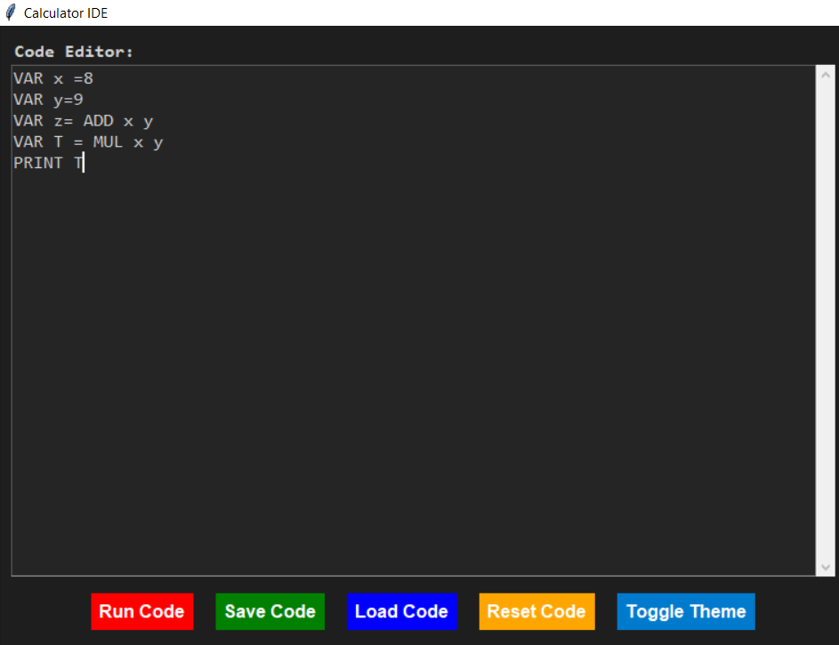
INPUT CODE

Slide 15
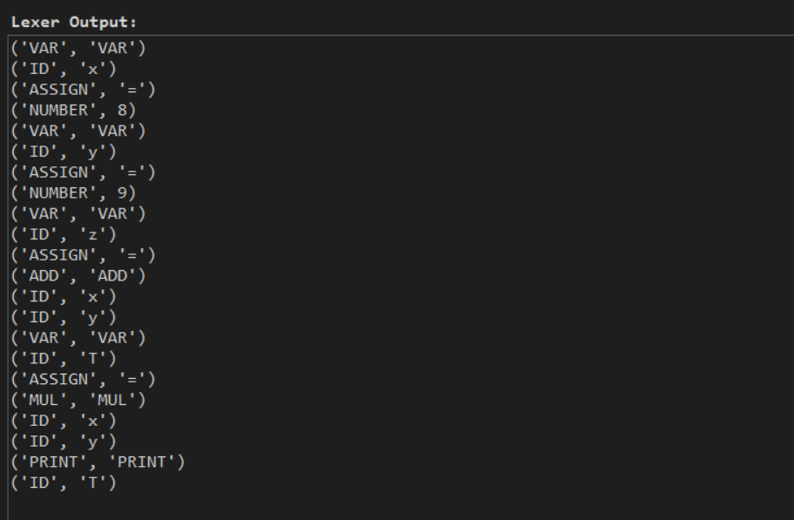
LEXER

Slide 16
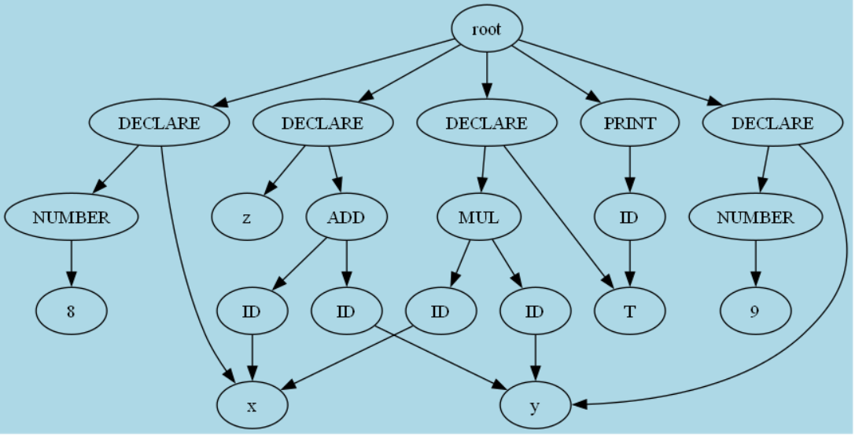
PARSER

Slide 17
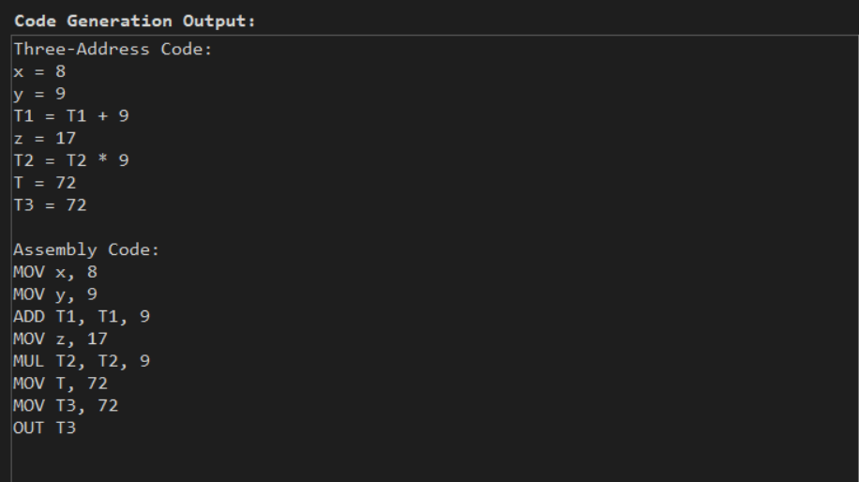
THREE ADDRESS CODE + ASSEMBLY CODE

Slide 18
THANK YOU
Page 10

